Slide 1

Integrating Perinatal Mood & Anxiety Disorders into Dignity Health’s Birthing Hospitals
Margaret Lynn Yonekura, M.D., FACOG
Gabrielle Kaufman, MA,LPCC,BC-DMT
Barbara Sheehy, MS

Slide 2
Objectives
Increase awareness about the significance of Maternal Mood and Anxiety Disorders(PMADs), including signs & symptoms
Understand the impact of PMADs on mothers and families
Learn about integrated care models
Learn general guidelines of screening for PMADs

Slide 3
Who are we?

Slide 4

Dignity Health Foundation
Humankindness in action
We believe in health care that fosters the physical, mental and emotional wellbeing of the most vulnerable people in our society. In partnership with Dignity Health and through the generosity of our community, we support investments that honor dignity and hope.
Dignity Health Foundation is a public, not-for-profit organization, as provided under Section 501(c)(3) of the Internal Revenue Code.

Slide 5
Maternal Mental Health NOW
Bringing together across sectors:
  Local organizations
  Experts from different fields
  “In and Out of the Box”
  Targeting higher risk communities
Structure: how we evolved
  Mostly volunteer
  Organizational development
Support:
  Funding
  Volunteer power
Public Awareness & Stigma Reduction
Education & Training
Policy & Advocacy

Slide 6
What is Perinatal Mental Health?

Slide 7

Maternal Mental Health - Overview
Perinatal* Mood and Anxiety Disorders, if untreated, can be devastating for patients and families
  “The Baby Blues”
  Pregnancy and Postpartum Depression
  Pregnancy and Postpartum Anxiety Disorders
  Postpartum Psychosis
* Anytime from conception through one year after delivery

Slide 8

Significance of Perinatal Mood and Anxiety Disorders
PMADs: 15-20% pregnancy and the postpartum period
  Low-income or minority women: 30-40%
  Incidence is 3x higher in postpartum
Major depressive disorder: 3-5%
The Baby Blues: > 80%, resolves on its own
AHRQ No. 119, 2005
Am J Psychiatry 2007; 164:1515-20

Slide 9
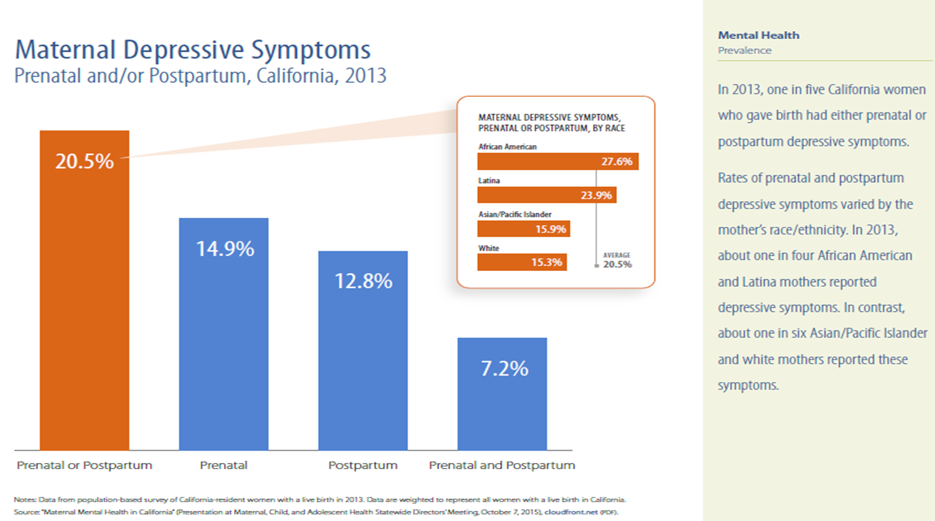

Slide 10
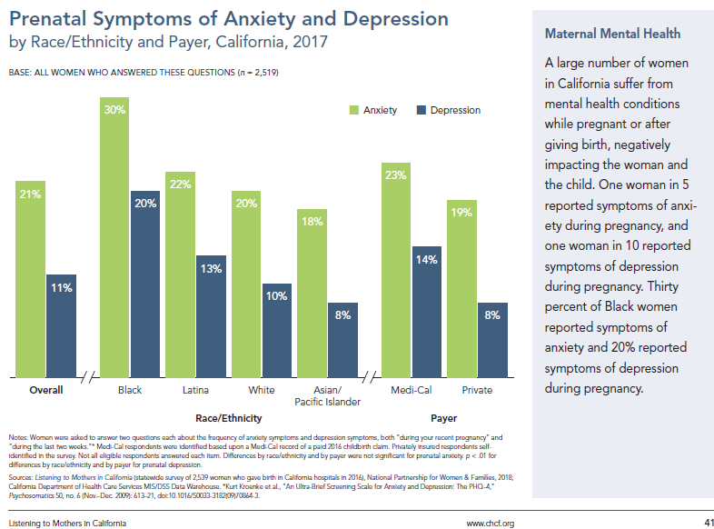

Slide 11
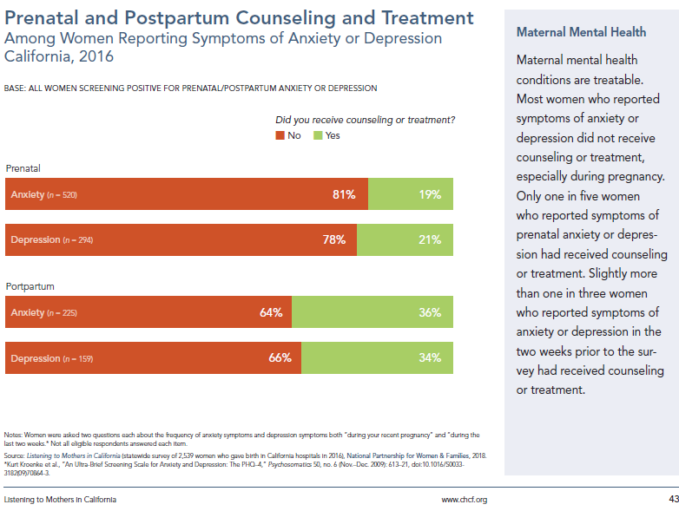

Slide 12
Significance of PMADs (cont’d)
PMAD is the most common complication of pregnancy
Untreated PMADs can have a devastating effect on women, their infants, and their families
Postpartum psychosis carries risk of suicide and/or infanticide
Maternal suicide within a year of birth exceeds hemorrhage and hypertensive disorders of pregnancy as a cause of maternal mortality, and is probably underreported
  70-fold increase of suicide in the first year after childbirth

Slide 13

No one is immune from PMADs
PMADs can affect any woman; even fathers aren’t immune
Cuts across age, race/ethnicity, income, education, and sexual orientation/expression
Culture can determine whether it is socially acceptable to acknowledge or discuss mental health concerns/issues
Culture may affect range of symptoms
Culture may influence treatment

Slide 14
Who is Impacted? Why Should We Care?

Slide 15

Why Does Maternal Mental Health Matter?
Risks to Mother
Infrequent or late-entry prenatal care
Appetite disruptions, poor weight gain
Sleep disturbances, fatigue
Increased risk of substance use
Increased risk of smoking
Suicidal thoughts and/or actions

Slide 16

Why Does Maternal Mental Health Matter?
Risks to Fetus / Neonate
Pre-term delivery
Low birth weight
Lower Apgar score
Elevated stress hormones

Slide 17

Why Does Maternal Mental Health Matter?
Risks to Infant
Increased crying and irritability for first 6 months
Decreased duration of breastfeeding
Increased risk of child abuse and neglect
Poor attachment to mother

Slide 18
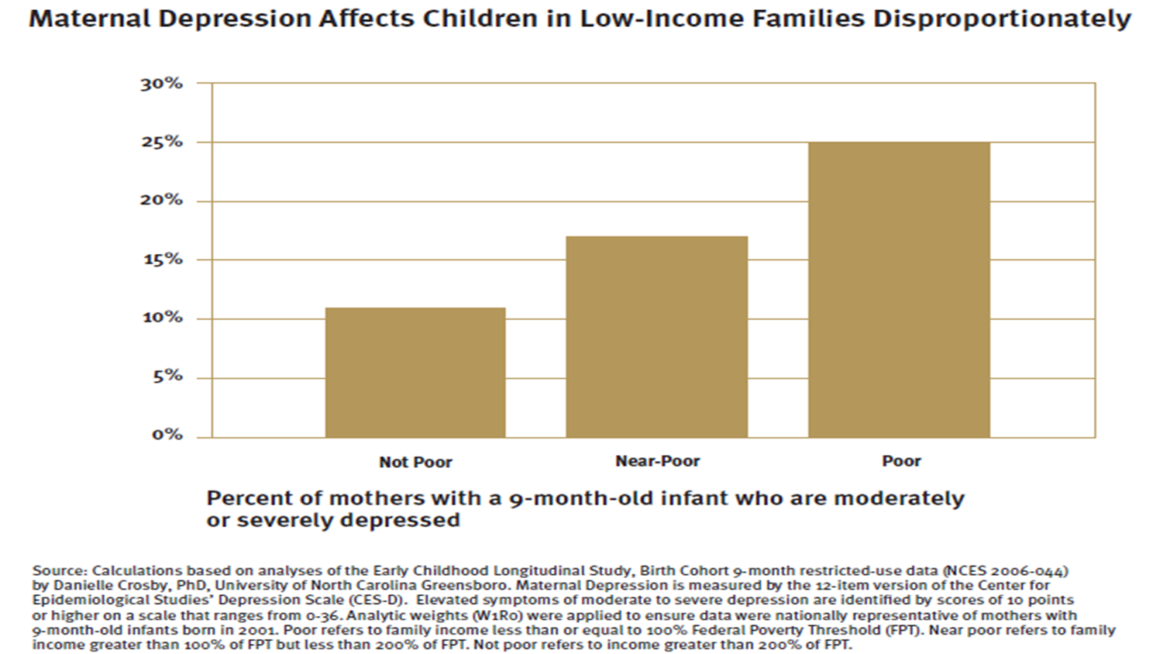

Slide 19

Why Does Maternal Mental Health Matter?
Risks to Child
Cognitive – lower cognitive performance, language delays, ADHD, learning disorders
Emotional - anxiety, mood disorders, phobias, panic disorders
Behavioral – conduct disorders; substance abuse
Family Life – 24-50% of dads depressed: strain on marriage, affects older children & extended family

Slide 20
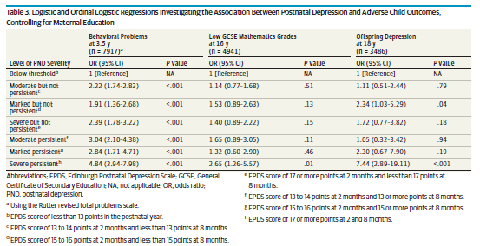
Association of Persistent and Severe Postnatal Depression with Child Outcomes
JAMA Psychiatry Published online January 31, 2018. doi:10.1001/jamapsychiatry.2017.4363

Slide 21
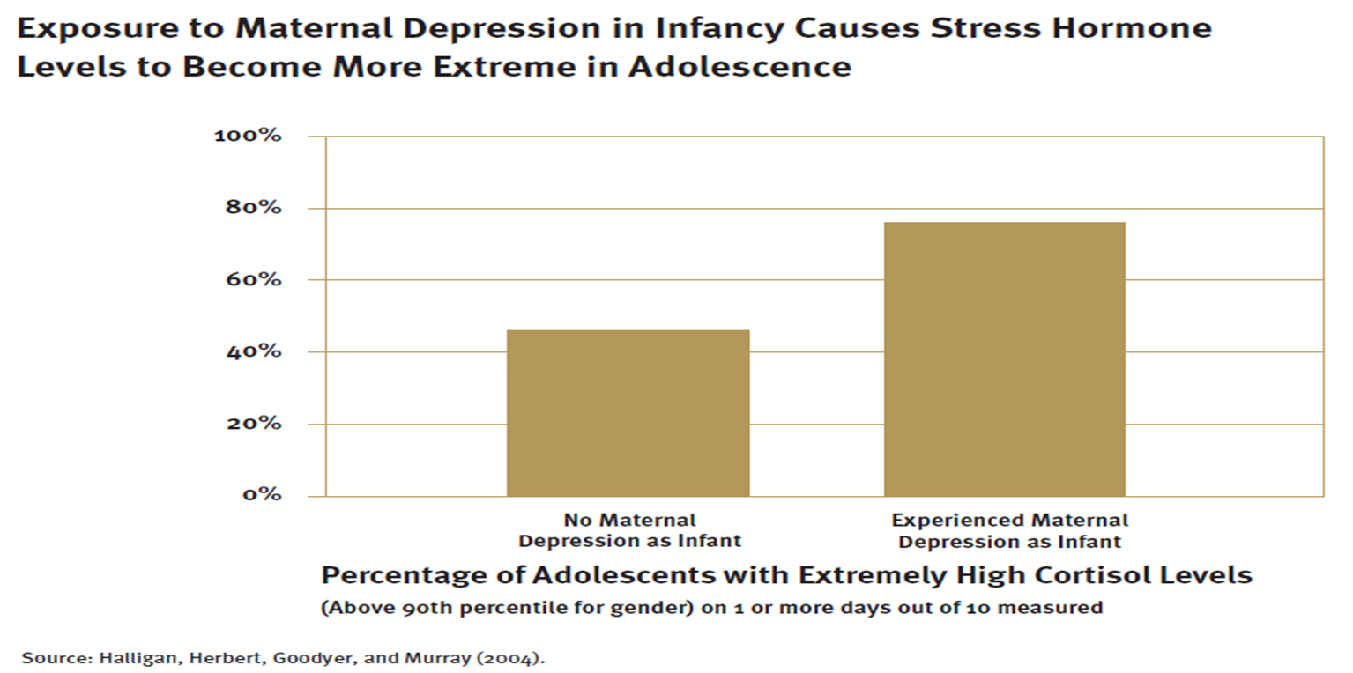

Slide 22
PMADs– Risk Factors
Pregnancy
Postpartum
Previous episode (30%)
Family history of depression and/or anxiety disorder
Substance abuse
Chronic pain issues
PH of trauma (ACEs)
Unhappily married, separated, divorced
Lack of social support
Complicated pregnancy
Primiparous
Infertility history
Unplanned pregnancy
Financial hardships
Physical/emotional stress (IPV)
High expectations & disappointment
Loss of own mother
Long/short interval between pregnancies
Unresolved (untreated) depression in pregnancy (increases risk for PPD 80%)
Previous postpartum depression (50%) or psychosis (70%)
Any previous depression
FH of depression/anxiety disorder or postpartum depression
Lack of social support
Social stress (finances, unemployment, IPV)
Birth or medical complication
Childcare stress: difficult temperament, inconsolable infant
Notes:
relative contribution of genetic factors (heritability) to prenatal & postnatal depression was 37% and 40%, respectively
if one sibling had an episode of postpartum major depression, the risk of an episode in the other sibling was increased fourfold
in women with a family history of narrowly defined postpartum major depression (onset within four weeks of delivery), 42 percent suffered depression after their first delivery ; By contrast, among women with no such history, only 15 percent suffered major depression within four weeks of their first delivery

Slide 23
Vulnerable Populations at Significantly Greater Risk
Teens
Single moms
Military women
Low income women
Poorly educated women
Recent immigrants
Women with high-risk pregnancies/hx infertility/hx miscarriage or stillbirth
NICU moms
LGBTQIA

Slide 24
Differential Diagnoses of PMADs

Slide 25

“The Baby Blues”
Impacts over 80% of women
Tearfulness, mood swings, feeling overwhelmed
May begin right after delivery
Symptoms last up to two weeks
Resolves on its own

Slide 26

Postpartum Depression = Major Depressive Disorder
Postpartum = “with postpartum onset”
Depressed/”low mood” OR
  Mood represents a change from person’s baseline
Decreased interest/pleasure (anhedonia)
> 2 weeks duration
Impacts functioning
Specific symptoms, at least 5 of these 9, nearly every day:
Notes:
Onset of depression:
Prepregnancy – 20 percent
●Antepartum – 38 percent
●Postpartum – 42 percent
Onset of PP major depression
PP month 1 54%
PP month 2-4 40%
PP month 5-12 6%

Slide 27
Postpartum Anxiety
Anxious feelings often accompany depression
Distractedness
Confusion
Worry
Irritability
Notes:
Onset of depression:
Prepregnancy – 20 percent
●Antepartum – 38 percent
●Postpartum – 42 percent
Onset of PP major depression
PP month 1 54%
PP month 2-4 40%
PP month 5-12 6%

Slide 28
Postpartum Depression = Major Depressive Disorder
DSM-5 Specific symptoms, at least 5 of these 9, nearly every day:
  Depressed mood most of the day, as indicated by either subjective report (e.g., feels sad, empty, hopeless) or observation made by others (e.g., appears tearful)
  Markedly diminished interest or pleasure in all, or almost all, activities most of the day
  Significant weight loss when not dieting or weight gain (e.g., a change of more than 5% of BW in a month), or decrease/increase in appetite
  Insomnia or hypersomnia
  Psychomotor agitation or retardation (observable by others)
  Fatigue or loss of energy
  Feelings of worthlessness or excessive or inappropriate guilt (which may be delusional)
  Diminished ability to think or concentrate, or indecisiveness
  Recurrent thoughts of death, recurrent suicidal ideation without a specific plan, or a suicide attempt or a specific plan for committing suicide

Slide 29
Major Depressive Disorder - What’s Different?
Pregnancy
Postpartum
No difference in DSM-5 criteria
Challenge: some of the criteria can look a lot like normal pregnancy
Multiple or severe physical complaints
Pronounced anxiety
Tearfulness
Severe low mood/hopelessness
Same “symptoms” as having new baby!
Sleep disruption, low energy, poor concentration
Agitation and pronounced anxiety, often mistaken for bipolar disorder
Disconnected from infant
Suicidality

Slide 30
QUESTION
“If you could have 8 hours to yourself in a nice, quiet, clean bed, would you be able to sleep?”
If the answer is NO, consider Postpartum Depression

Slide 31
Postpartum Obsessive-Compulsive Disorder
OCD may begin in the perinatal period OR severity of preexisting symptoms may worsen
General prevalence: 2-3%; higher in the postpartum period
Compulsive/repetitive behaviors (cleaning, counting, checking)
Intrusive/repetitive thoughts/images
Presents as thoughts of harming child, often accompanied by anxiety-reducing behaviors
Very upsetting to mother; she recognizes these thoughts as “foreign”

Slide 32
Postpartum Post Traumatic Stress Disorder
Reliving of past traumatic events
Flashbacks, nightmares, images
Sense of doom
Hyper-vigilance
Increased arousal
Can be caused by birth trauma (subjective) – birth can also trigger early trauma
  1-3% develop PTSD as direct response to birth

Slide 33

Postpartum Psychosis: A True Emergency
VERY RARE – occurs in 1-2/1000 births
Most often seen in women who have been or will be diagnosed with bipolar disorder but can also occur in women with a major depression with psychosis, schizophrenia or schizoaffective disorder
  25-40% of deliveries in women with bipolar disorder are affected by postpartum psychosis
  ~20% of women with schizophrenia or schizoaffective disorder develop postpartum psychosis
Is she talking about hurting herself or the baby?
A true medical emergency – baby and mother at risk
CALL 9-1-1
Don’t leave mother alone with baby
2/1000 will commit suicide; 4% commit infanticide

Slide 34
Screening for PMADs

Slide 35
Current Position Statements
American Academy of Pediatrics published a guideline in 2010
  Advocated for pediatricians to screen mothers for depressive symptoms at well child visits at 1, 2, and 4 months of age
  Recognized that maternal depression can cause failure to thrive and other pediatric issues if unrecognized
ACOG published Committee Opinion #630 in May 2015
  Recommended that obstetricians “screen at least once during the perinatal period for depression and anxiety symptoms using a validated tool”
  Listed various acceptable screening tools
US Preventive Services Task Force Recommendation Statement, Jan. 2016
  Recommended depression screening for pregnant women. Screening should be done both antepartum and postpartum.
Council on Patient Safety in Women’s Health Care, Feb. 2017
  Provided recommendations for establishing screening for depression and anxiety in all obstetrical practice settings

Slide 36
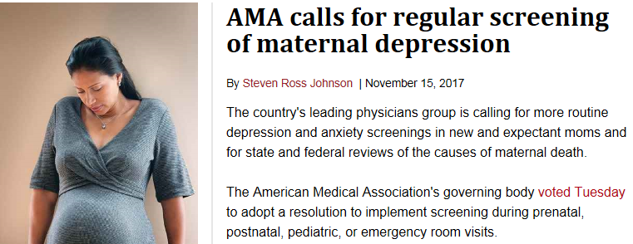

Slide 37

September 27, 2018
Governor signs 3 MMH bills:
AB 2193 MMH Screening & Support requires obstetric providers to confirm that screening for maternal depression has occurred or to screen women directly, at least once during pregnancy or the postpartum period. It also requires private and public (Medi-Cal) HMOs and PPOs to create MMH programs. Effective on July 1, 2019.
AB 3032 Hospital MMH requires hospitals to provide MMH training to clinical staff who work with pregnant & PP women, and to educate women and families about the signs and symptoms of MMH disorders as well as any local treatment options. Effective January 1, 2020
AB 1893 MMH Federal Funding was signed by Governor on July 20, 2018 and requires the state Department of Public Health to apply for federal funding provided through the Bringing Postpartum Depression Out of the Shadows Act (part of the 21st Century Cures Act)

Slide 38
Screening for Perinatal Mood and Anxiety Disorders
Who Should Be Screened?
How?
All Women: YOU MUST ASK
No woman is risk-free
Few women will volunteer
Use a Validated Screening Tool
Edinburgh Postnatal Depression Screen
Beck Depression Inventory
Patient Health Questionnaire-9

Slide 39
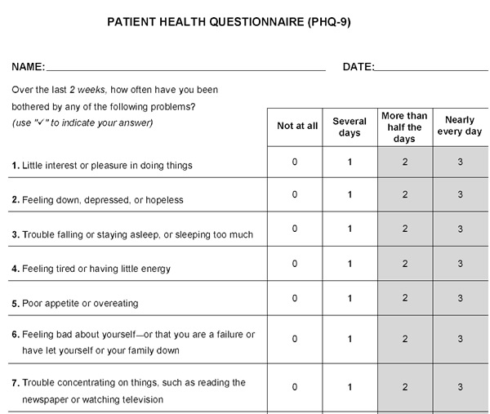
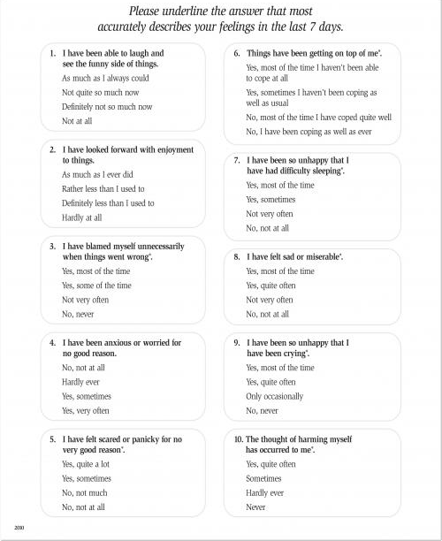
Clinical judgement should always be used when using a standardized screening tool.
Notes:
Screening Tool EXAMPLE

Slide 40
Edinburgh Postnatal Depression Scale: Referral Algorithm
EPDS Score <10
Normal negative screen-likely not suffering at this time
Use clinical judgement regardless of EPDS score
EPDS Score 10-12
At risk for depression and/or anxiety
Social work referral and notify OB provider
EPDS Score >13
Positive screen- likely suffering from depression and/or anxiety
Social work referral and notify OB provider
>0 on Question #10
Provide verbal & written education about risks/incidence (Brochure available)
Discuss results and provide education
Social worker – screen for additional needs
Discuss results and provide education
Social worker – complete Maternal Child Assessment
Maternal Crisis – At risk of harm to self or others
Social work referral and notify OB provider immediately
Social worker – Complete Mental Health Assessment

Slide 41
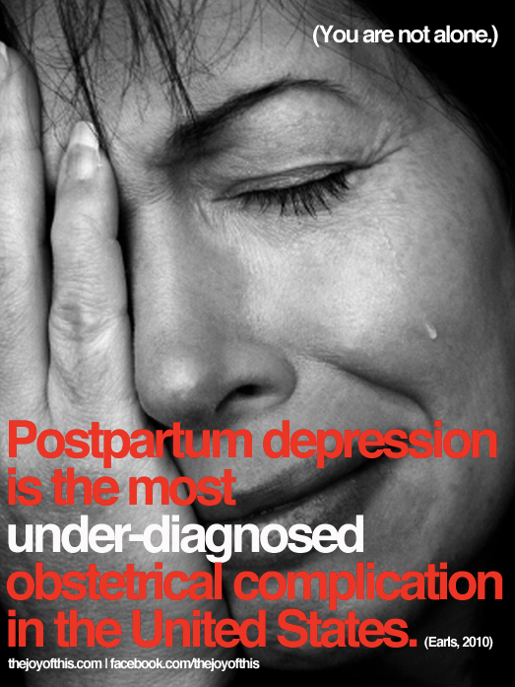
When To Screen in Pregnancy?
At initial intake
At each trimester
The reason? Early detection

Slide 42

When to Screen Postpartum?
Highest risk: 10-19 days after delivery
Next highest risk: first three months
Most cases occur within five months
Anecdotally, another cluster emerges at 6-8 months

Slide 43

Guidelines for Postpartum Depression Screening
Two weeks
Six weeks
Six months

Slide 44
Barriers to Screening and Care
Time
Comfort level of care providers
Concern about acceptability to patients
Stigma
  Symptoms ignored, minimized, denied
  Double standard: “OK to treat physical”

Slide 45
What to do with a positive screen?
Decide to treat the patient yourself
  Complete assessment
  Work with patient to determine treatment plan
  Determine team for collaboration (psychotherapy, psychiatry)
Refer to Mental Health Specialist
  Patient preference
  Comorbidities: Psychotic, bipolar, obsessive-compulsive, or panic disorder
  Active substance abuse
  Acute suicidality

Slide 46
What To Do If You’re Worried About Suicidality
Have clinic policy in place – knowing what to do makes screening easier
Never leave patient alone, not even to go to bathroom!
Options
  Calling 9-1-1
  Calling Psychiatric Emergency Team (PET)
  Calling Mental Health Specialist On-site

Slide 47
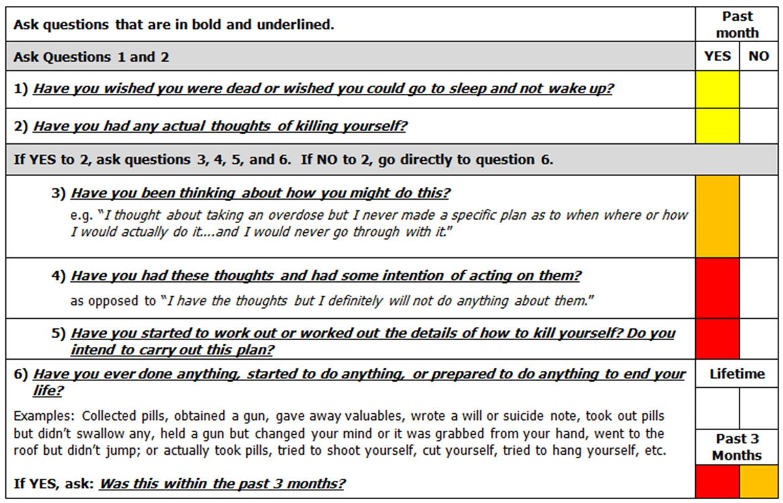
Columbia-Suicide Severity Rating Scale (C-SSRS)

Slide 48
What can we do to help?

Slide 49
The Universal Message
You are not alone
You are not to blame
With the right help, you will get better
              Postpartum Support International

Slide 50
Supportive Interventions
Educating ALL patients and families
Active listening, encouragement, support
Focusing on solutions
Helping the woman make changes herself and accept help
Notes:
Circle of Support: write the names of 5 people who provide social support; place them closer to circle or farther from circle based on how you are to them; who would you call on to do grocery shopping for you; help you with childcare; who could you talk to if you had a really bad day,

Slide 51
Types of Treatment - Considerations
Psychotherapy from a clinician with specific training in perinatal mental health
Interpersonal Psychotherapy (most studied)
Cognitive-Behavioral Therapy
Psychodynamic Therapy
Support Groups
Involving partners is essential (couples therapy)
Medications

Slide 52
Partnership with MMH NOW
Train all staff on PMADs, Screening & interventions
  Hospital RN, MD, LMFT/LPCC/LCSW, Lactation
  Partner agencies in the community - referrals
Medical Doctor trainings
  Including medication guidelines
Regional trainings
Group Therapy Training
Monthly consultation calls
Psychiatric consultation line for physicians

Slide 53
Dignity Health’s Maternal Mental Health Program

Slide 54


Dignity Health’s Vision-Maternal Mental Health Care
To be a national model of excellence that actively promotes maternal and infant well-being and reduces the burden of illness that is associated with untreated or inappropriately treated Perinatal Mood and Anxiety Disorders (PMADs).
We seek a two-generation solution, recognizing the impact PMADs have on the mother and the infant.
Building on Dignity Health’s promise of humankindness, and the healing power of personal connection, we will work with community partners to provide the range of services women and families need.
Notes:
Barbara

Slide 55

Dignity Health Hospital System & Maternity Care
29 hospitals with maternity services across AZ, CA and NV
60,000 babies delivered annually
1,800 perinatal nurses
1,200 OB/GYN and Pediatric providers
67% of OB patients covered by Medicaid
Notes:
Barbara

Slide 56
FY 2016
Data Source: Midas
Total Births = 58,693

Slide 57
Maternal Mental Health Project Timeline
Notes:
Barbara

Slide 58
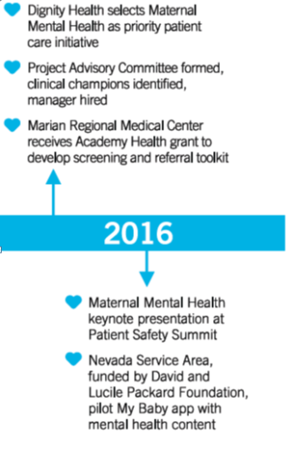

Year One Getting the project off the ground
Step 1: Engaging Executive Leaders
Step 2: Secure Funding
Step 3: Appoint Project Lead
Step 4: Project Advisory Committee
Step 5: Screening & Referral “Pilot Project”
Step 6: Introducing MMH to the system
Step 7: IT “Pilot Project”
Notes:
Barbara

Slide 59
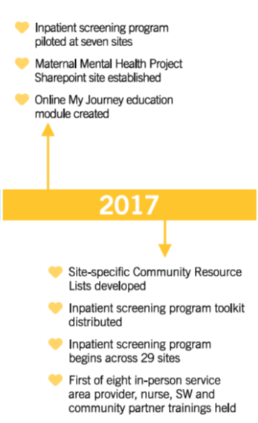
Year Two …………..Gaining momentum!!
Step 1: ”Pilot” Inpatient Screening Program
Step 2: System Resources: SharePoint Site
Step 3: PMADs online education for perinatal staff
Step 4: Generic and community resource guides
Step 5: Toolkit Announcement
Patient Brochure
EPDS Form
EPDS FAQs
EPDS Algorithm
Step 6: Launch, Office Hours
Step 7: Plan and launch in-person training
Notes:
Barbara

Slide 60
PMADs Toolkit & Postnatal Inpatient Screening Program
Notes:
Barbara

Slide 61
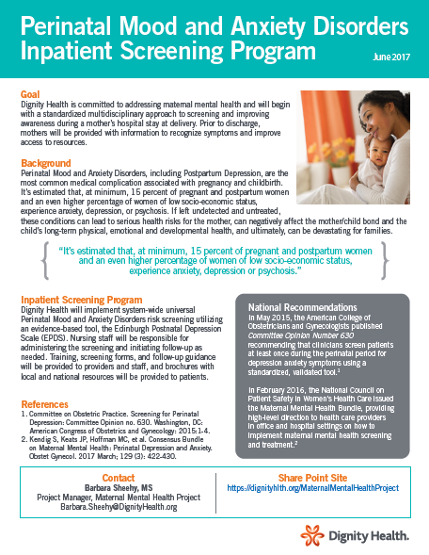
Toolkit: Announcement
Notes:
Barbara

Slide 62

Toolkit: Patient Brochure

Slide 63
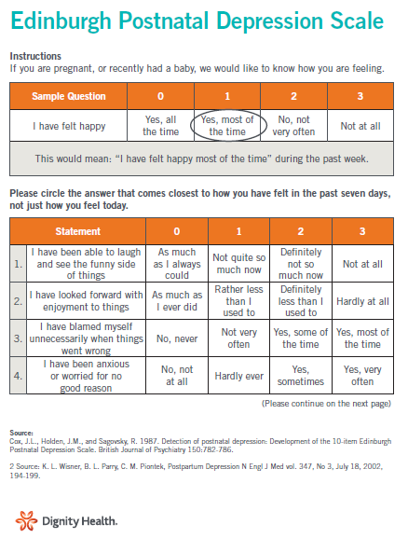
Toolkit: EPDS Form
Notes:
Barbara

Slide 64
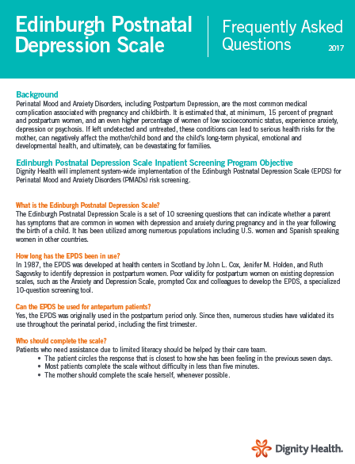
Toolkit: Frequently Asked Questions (FAQs)
Notes:
Barbara

Slide 65
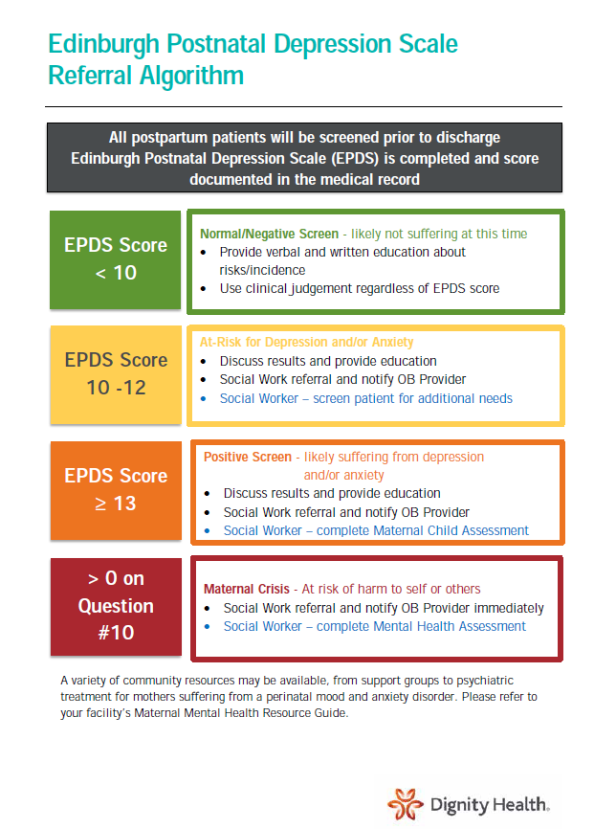
Toolkit: Referral Algorithm
Notes:
Barbara

Slide 66
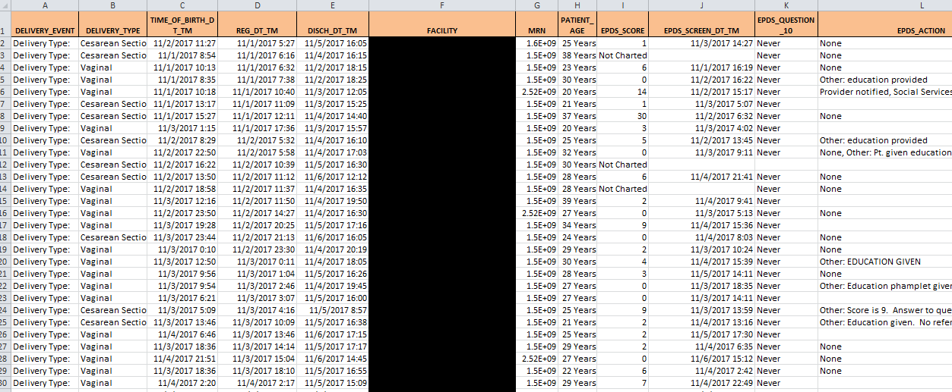
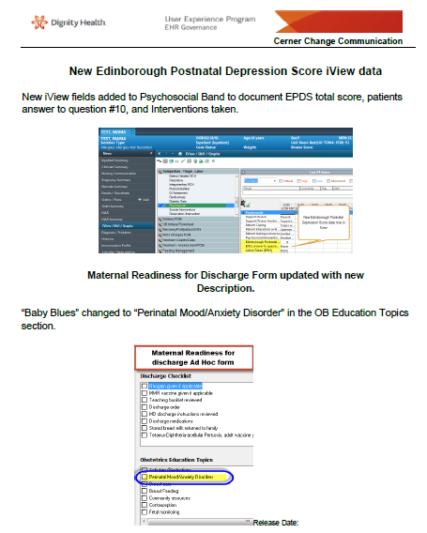
Documentation and Data

Slide 67
Perinatal Goal - Measure Definition
Screening for Perinatal Mood and Anxiety Disorders
Numerator | Medical record includes the following bundle elements, if applicable: Results of EPDS tool documented prior to discharge Patients with a score ≥10 (at risk) receive a Social Services referral Patients with a score ≥13 (positive screen) and/or >0 on Question #10 (self-harm) receive mental health evaluation by MCH Social Worker and notification to provider Education provided and documented
Denominator | All obstetrical patients with a “delivery” encounter

Slide 68

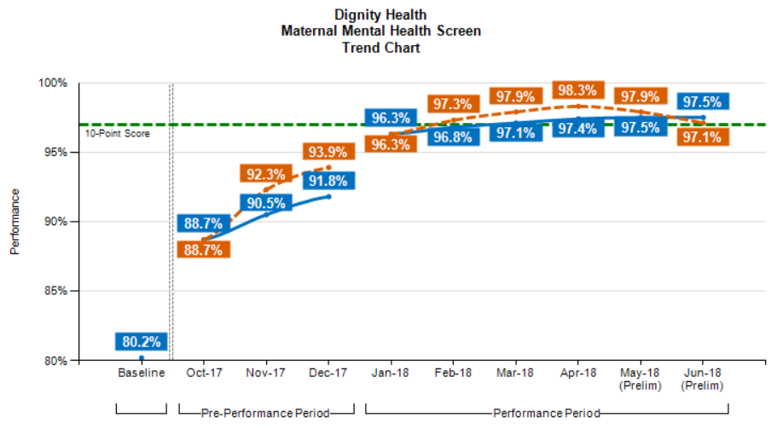
FY18 Perinatal Goal – Current Performance

Slide 69
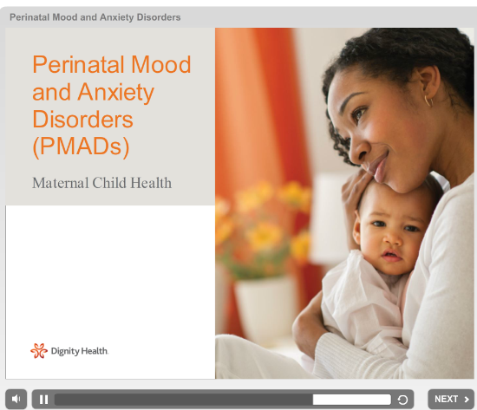
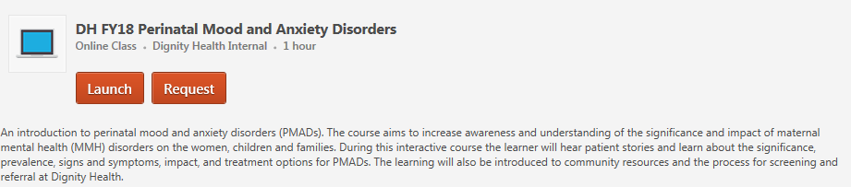
Training – Online Education
My Journey Module –completed by 2,683 staff

Slide 70
System-wide In-Person Training

Slide 71


More than Just the Blues: Perinatal Mental Health
Trainer - Gabrielle Kaufman, MA, LPCC, BC-DMT
319 Participants
1,914 Training Hours

Slide 72

It Takes a Village: Creating Support Groups for New Moms
Gabrielle Kaufman, MA, LPCC, BC-DMT
244 participants
732 training hours

Slide 73
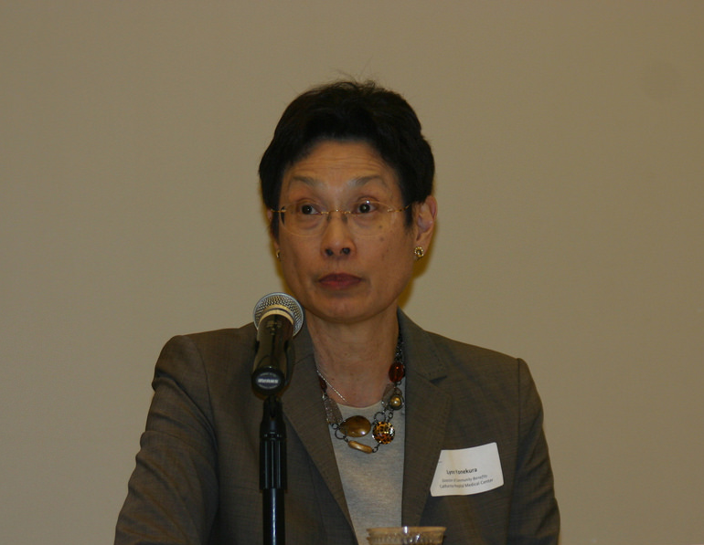

Integrating Perinatal Mental Health into Your Medical Practice
Margaret Lynn Yonekura, MD & Miriam Schultz, MD
192 participants
384 training hours

Slide 74
Training Attendance
Dignity Health vs. Non – Dignity Health Participants

Slide 75
Training Attendance
Total % of Participants by Discipline

Slide 76
My Baby
Pregnancy Journey App

Slide 77


My Baby Deployment
Nevada
12/2016
Arizona
05/2017
Central Coast
12/2017
GSSA
06/2018

Slide 78
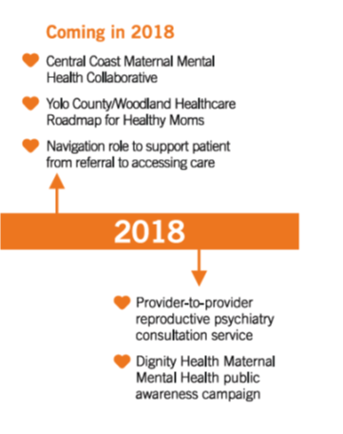
Year Three…………..Where are we now?
Step 1: Local community collaboratives, pilot navigator role
Step 2: Developing consultation service
Step 3: Communication plan

Slide 79


Perinatal Psychiatry Consultation Service
Provider-to-provider telephonic consultation to enhance the capacity of primary care and specialty providers to serve, when possible, as the mental health home base for their perinatal patients.
Psychiatrists with expertise in perinatal period coach OB, Family Practice and Psychiatric providers on diagnosis, treatment planning and pharmacology.

Slide 80
Thank you

